Slide 1


Slide 2
COMPANY OVERVIEW
Incorporated in 2011 as NFLabs, Inc
Venture backed
Locations in Seoul, SK and California, US.
Leading the big data discovery revolution

Slide 3

Apache Zeppelin
Incubating

Slide 4
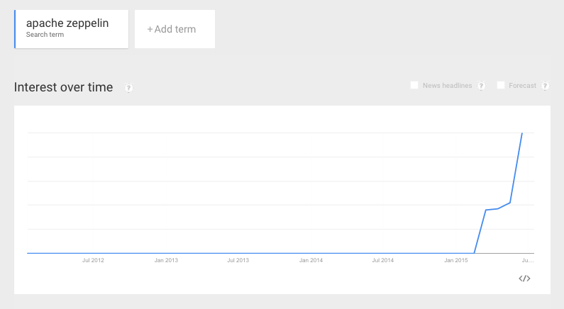
ZEPPELIN POPULARITY GROWING — GOOGLE TRENDS
Hadoop and Spark Summit (June 2015)
1 month after apache incubation

Slide 5
ZEPPELIN OPEN SOURCE ADOPTION—in Less than 9 months
Contributors
Watch
Stars
“We’re super impressed by Zeppelin” engineers at Spotify

Slide 6



ZEPPELIN—OPEN SOURCE COMMUNITY SUPPORT
*
Above frameworks all integrated onto Zeppelin—by the community

Slide 7
















COMMERCIAL ADOPTION—COMPANIES USING ZEPPELIN

Slide 8
ZEPPELIN—ROADMAP
Release 0.5.0 — 0.6.0
Pluggable Visualization
Standard JDBC Support
Job/Workflow Management
R integration
Security enhancements
Angular Framework—experimental to beta

Slide 9
STATE OF OPEN SOURCE IN ENTERPRISE

Slide 10
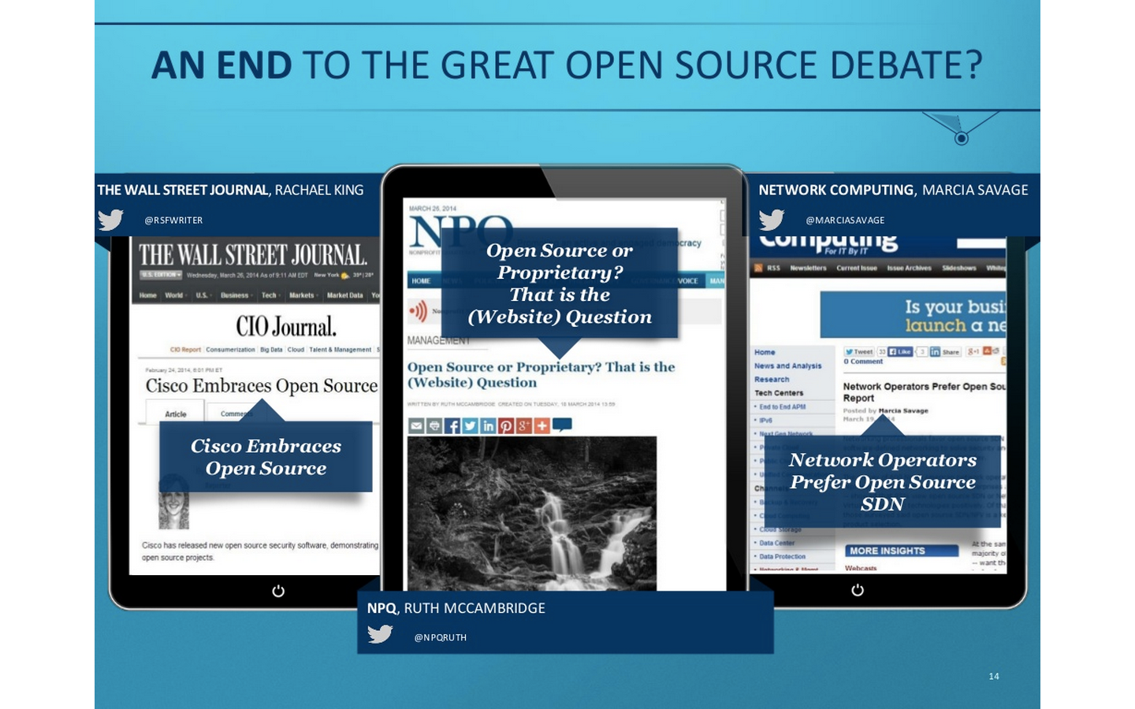

Slide 11
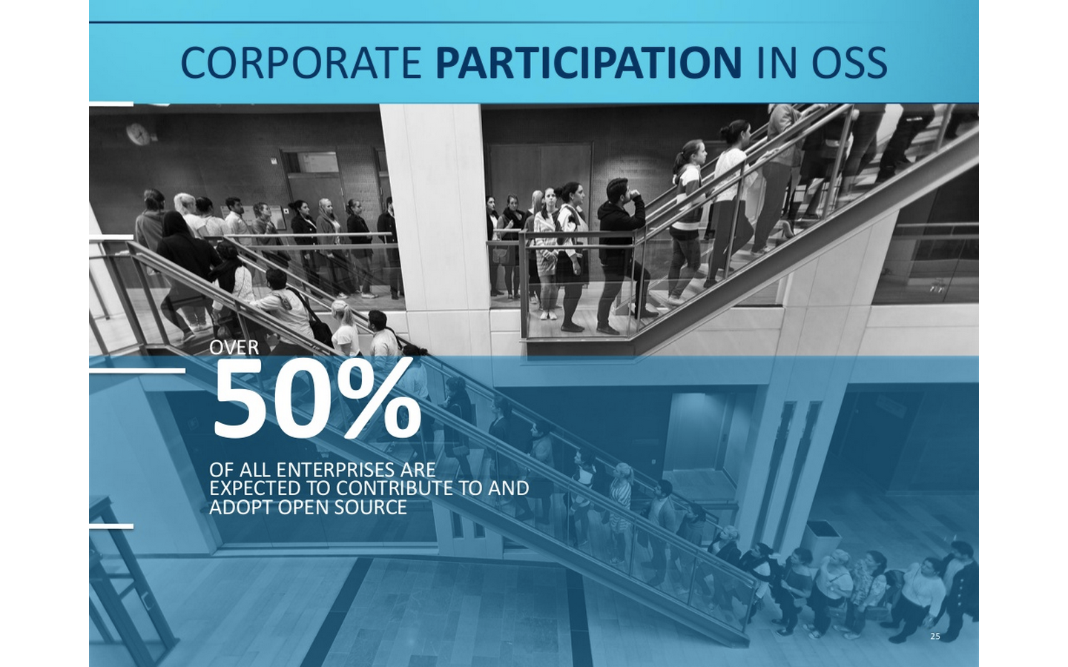

Slide 12
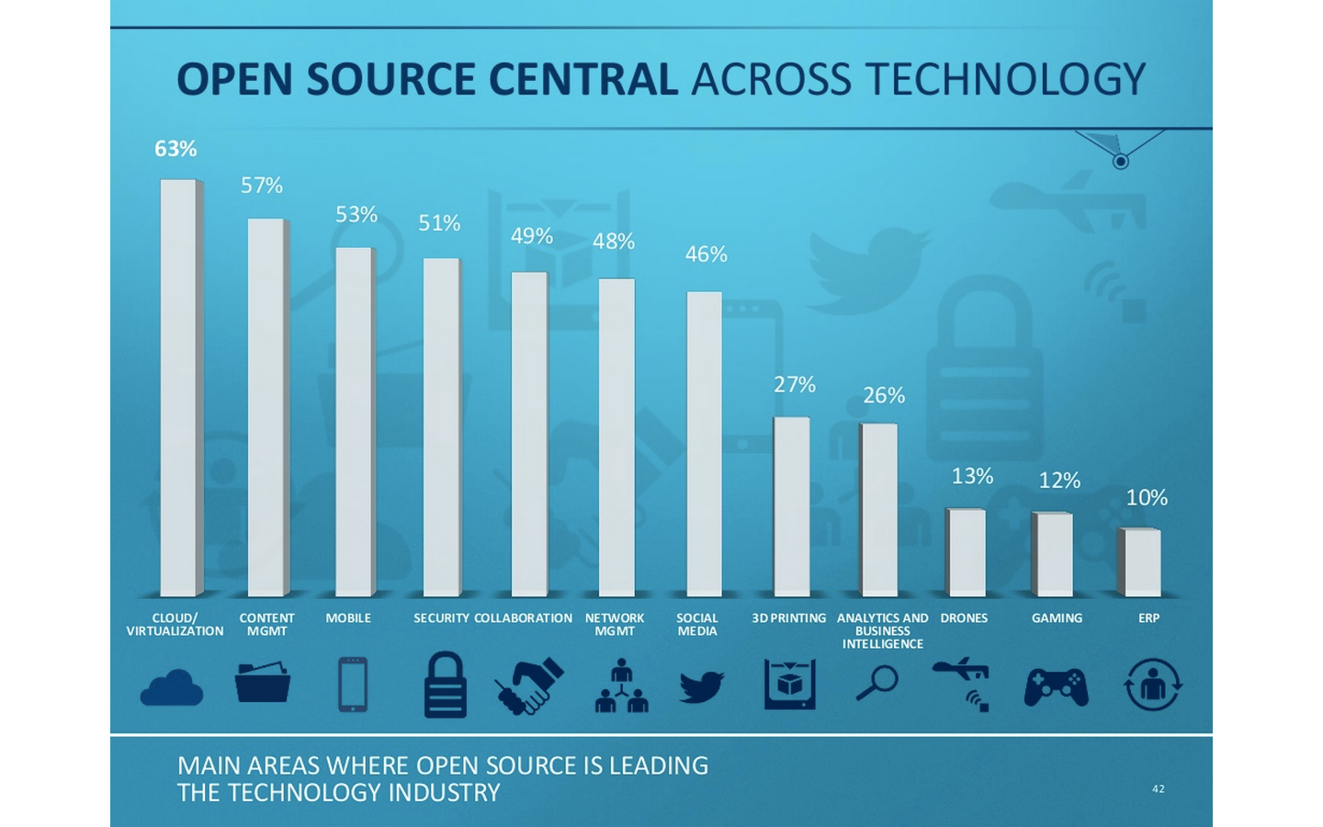

Slide 13
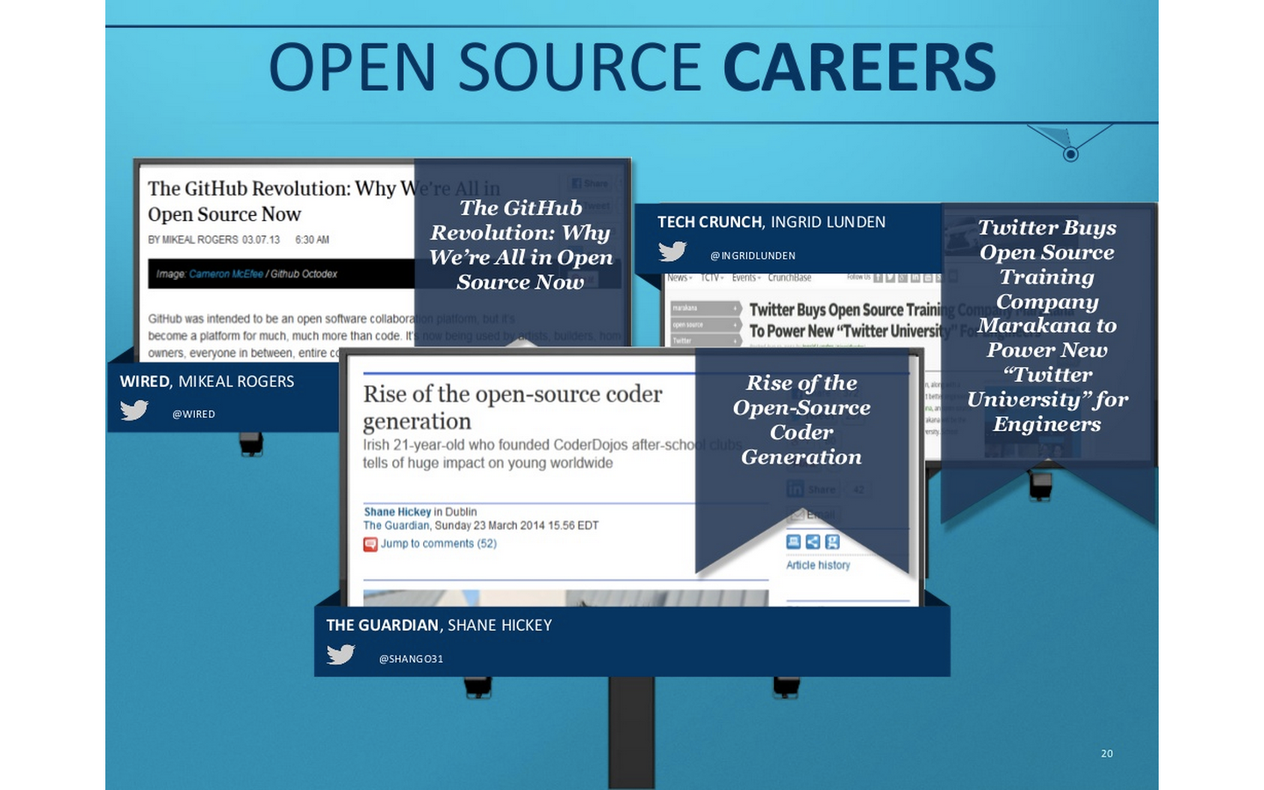

Slide 14
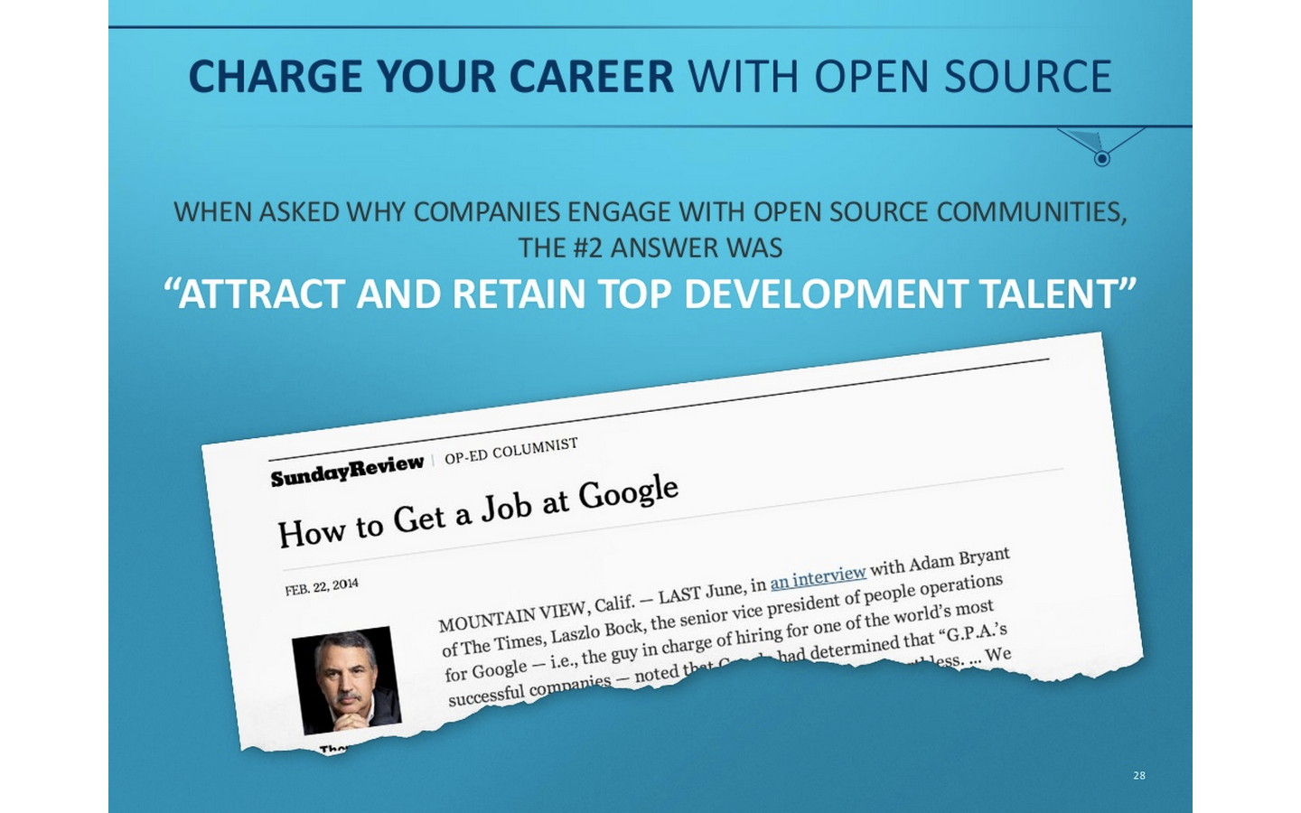

Slide 15
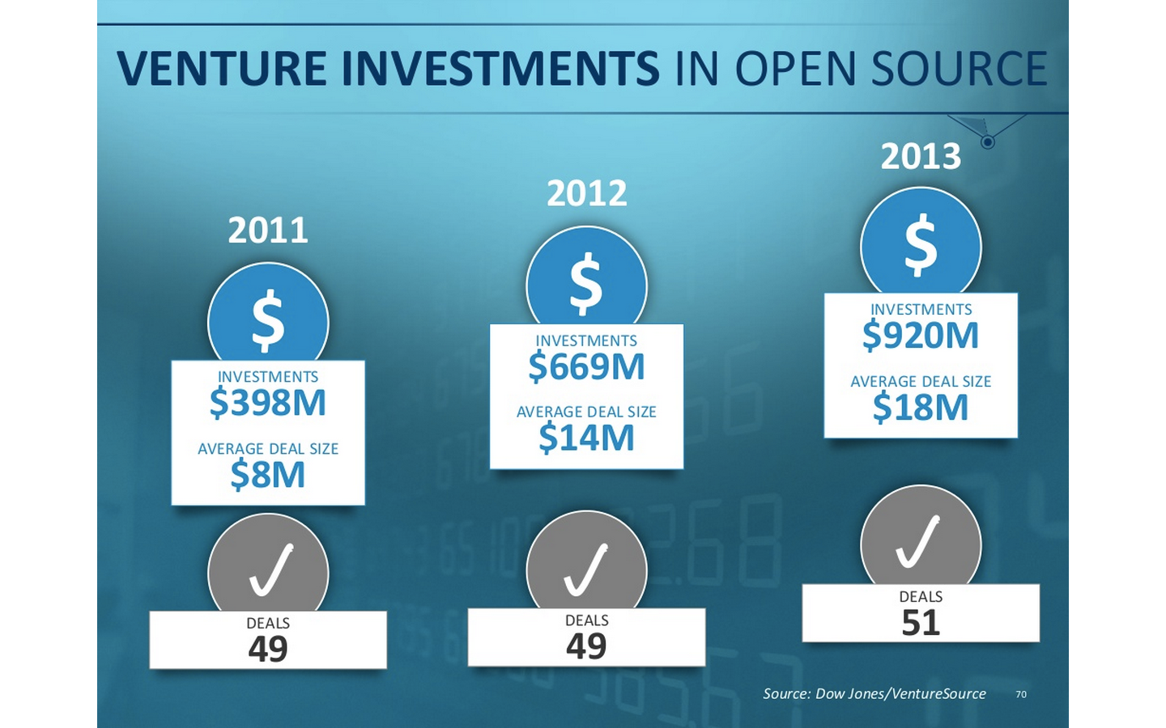

Slide 16
OPEN SOURCE IN BIG DATA

Slide 17
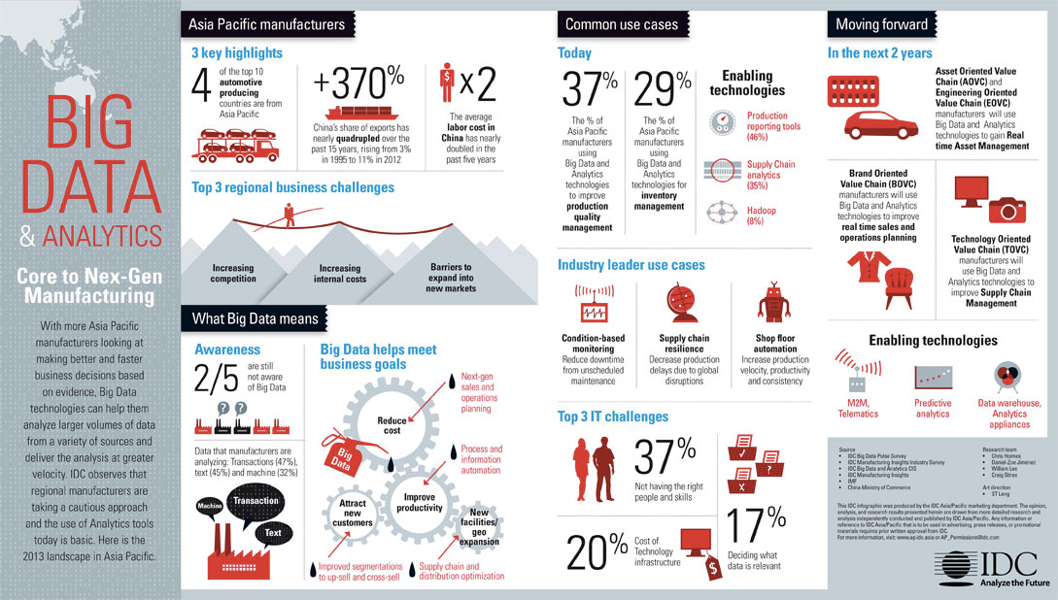
Big Data Impact

Slide 18





OPEN SOURCE IN BIG DATA

Slide 19





OPEN SOURCE IN COMMERCIAL
$14.5B IPO market capitalization
Raise @ $5 market capitalization
$1.2B IPO market capitalization
Acquisition by Sun Micro @ $1B
Raise @ $1B market capitalization
$100M investment in Apache Spark
HD Insight investment on Azure

Slide 20
“Software is eating the world” Marc Andreessen
“Open source software is eating the Enterprise world”

Slide 21



THANK YOU
http://zeppelin.incubator.apache.org/
https://github.com/apache/incubator-zeppelin
@koreabigdata
www.nflabs.com

